Slide 1
SUPPORT VECTOR MACHINES (SVM)
Main reference: Chapter 5 of Géron, A. (2019). Hands-on machine learning with Scikit-Learn, Keras, and TensorFlow.

Slide 2


Introduction
A Support Vector Machine (SVM) is a very powerful and versatile ML model,

Slide 3
Classification with linear SVM models

Slide 4


Linear SVM
>> Go to code.

Slide 5
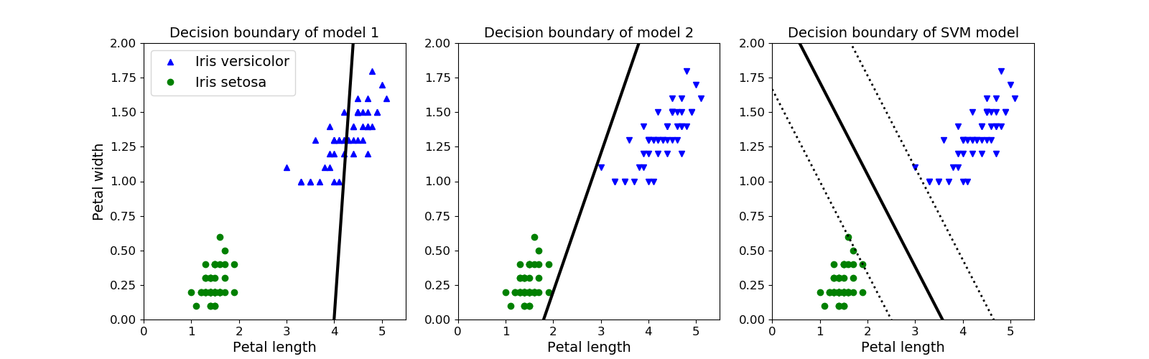




Large margin classification

Slide 6
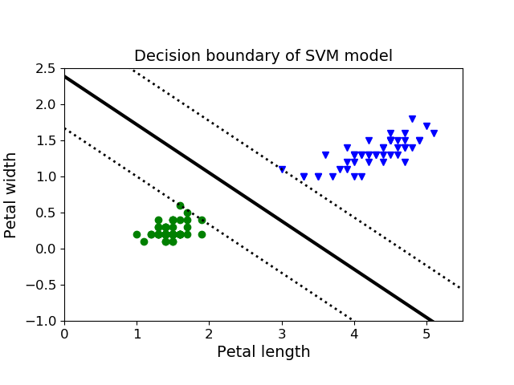

Support vectors
Support vectors:

Slide 7
Hard margin vs soft margin

Slide 8







Hard margin
Hard margin:
➔ Problems:
>> Code

Slide 9





Soft margin
Soft margin:
➔
Implementation note:

Slide 10
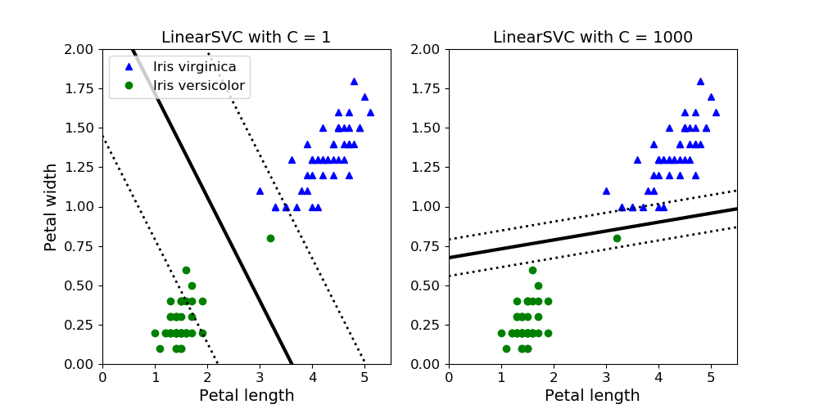


Soft margin
Larger margin ➔

Slide 11






Classification with nonlinear SVM

Slide 12
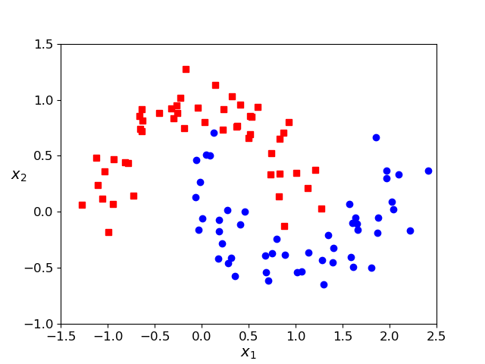









Method 1: Add polinomial features
(similar idea to polynomial regression)
➔

Slide 13







Kernel trick for method 1
Polynomial models can deal with non-linear data.
However,
➔ Kernel trick:
>> Code

Slide 15








Method 2: Add similarity features

Slide 16


Similarity functions
Used to measure similarities b/w samples.
Some similarity functions:
Euclidean distance
String kernels
Gaussian Radial Basis Function

Slide 17
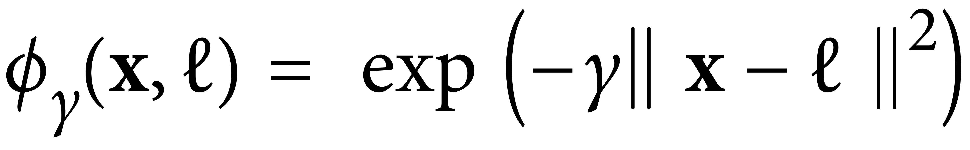






Gaussian kernel
Gaussian (RBF) kernel function:

Slide 18




Data transformation
Given a 1D data (data with 1 feature):
1 landmark ➔ add 1 new feature:
2 landmarks ➔ add 2 new features:
K landmarks ➔
Data are transformed into
>> Code

Slide 19




How to select the landmarks?
The simplest way:
Higher dimension:
However, with m samples, you add m features ➔
➔ Use kernel trick!

Slide 20








Kernel trick for method 2
Kernel trick:
Which kernel to use?
Always try the linear kernel first
Gassian kernel works well in most cases
Try a few other kernels using grid-search

Slide 21





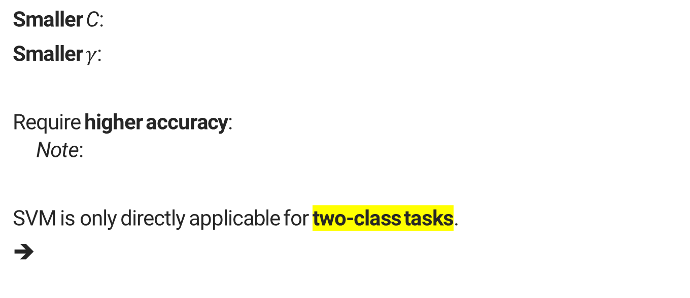





Discussions and notes
Smaller C:
Smaller $γ$:
Require higher accuracy: Note:
SVM is only directly applicable for two-class tasks.
➔

Slide 22






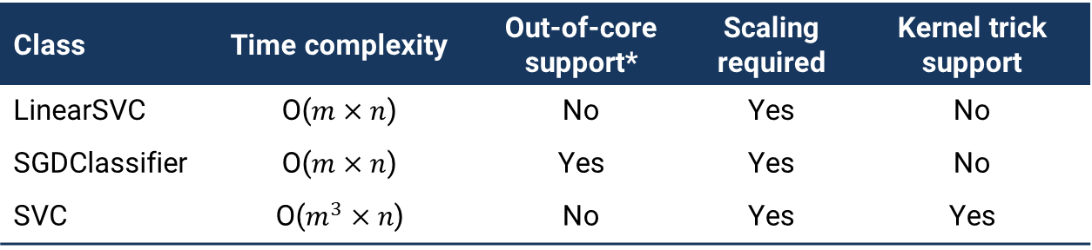






Comparison of SVM implementation in sklearn
Class | Time complexity | Out-of-core support* | Scaling required | Kernel trick support
LinearSVC | O($m×n$) | No | Yes | No
SGDClassifier | O($m×n$) | Yes | Yes | No
SVC | O($m^{3}×n$) | No | Yes | Yes
*Out-of-core support: not require to load all training samples into the memory for training.
Note:
Credit: (Géron, 2019)

